Slide 1
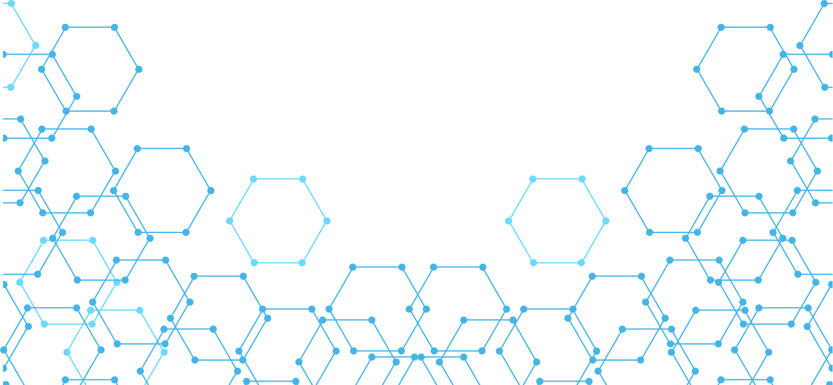
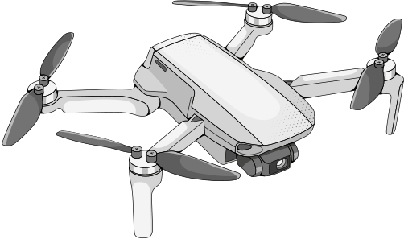
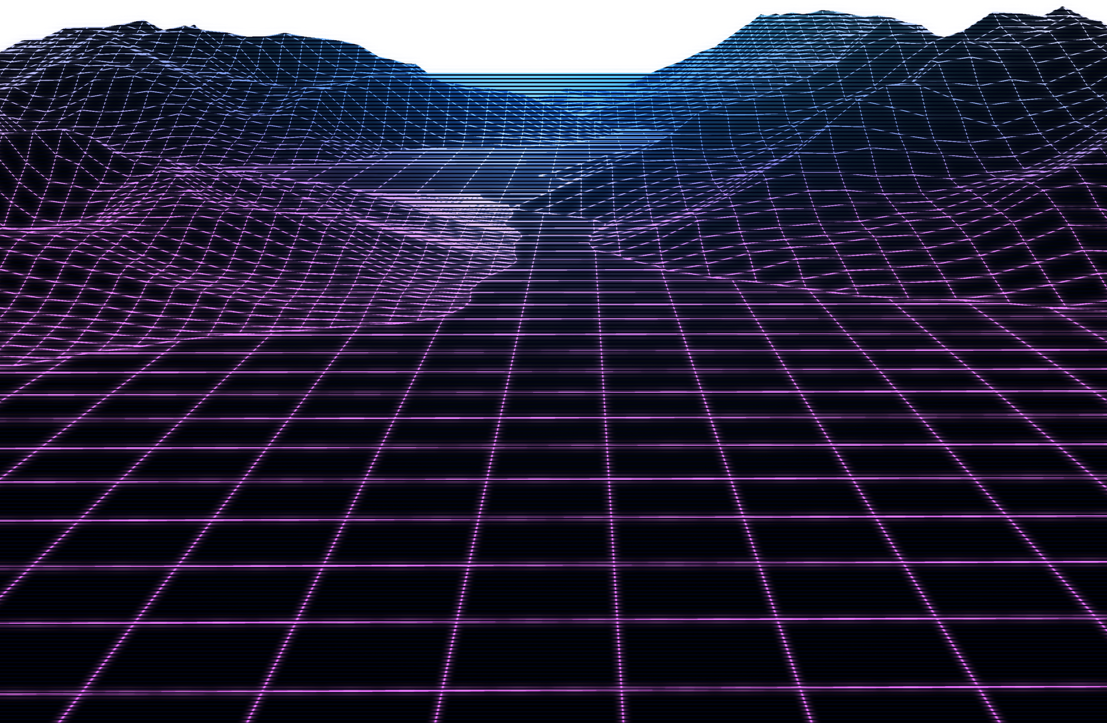
CV5570: MID-TERM PROJECT REVIEW
BIM-Based Construction Progress
Monitoring via Drone Simulation

Slide 2
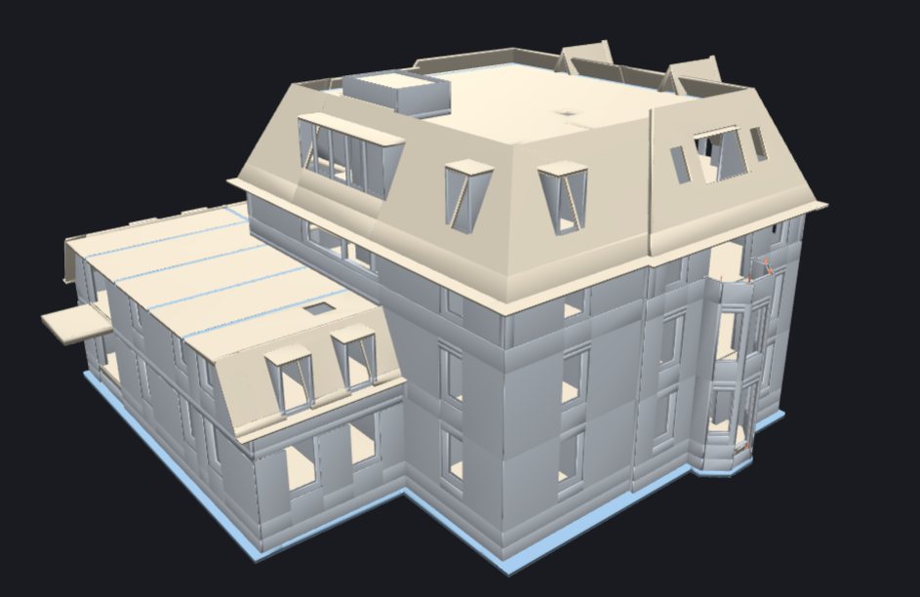
A BIM tells you what SHOULD be built — not what IS
Problem
  A design BIM encodes intended geometry: every wall, slab, beam and column, exactly as planned.
  It says nothing about what has actually been constructed on site.
  Manual progress inspection (walkthroughs, photos, spreadsheets) does not scale to large or fast-moving sites.
Solution
  Drone collected video → point cloud data
  Determine which BIM elements are built
  Estimate overall project progress
BIM and schedules taken from “Schependomlaan” - Dutch residential project, TU Eindhoven / RAAMAC — IFC2x3 design model from Archicad.

Slide 3
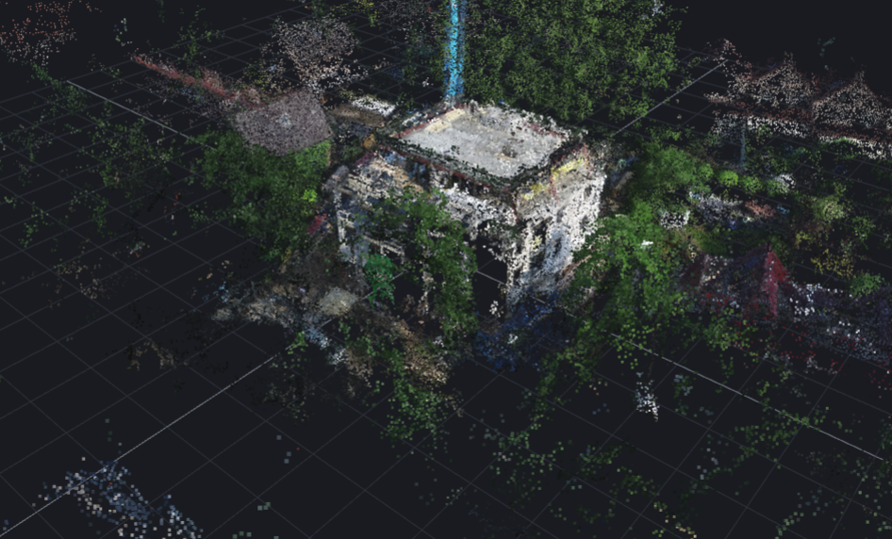
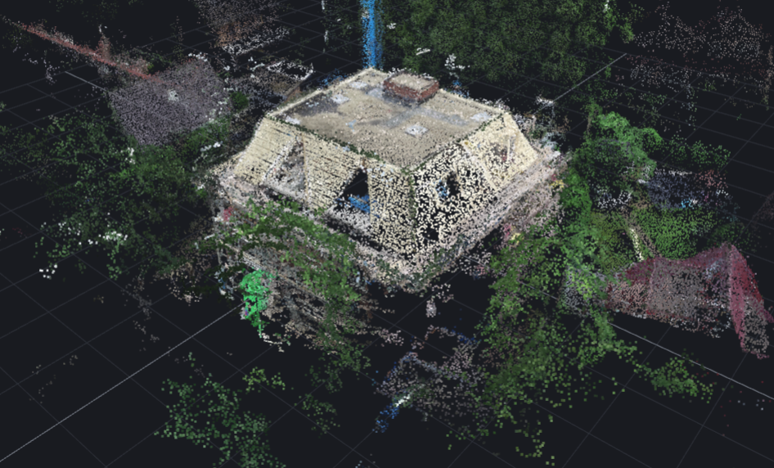

Why Simulate?
Week 27
Week 30
  Inconsistent elements - some walls, windows etc would be present in a previous but not the current one
  Whole building with multiple floors constructed without some parts of the foundation, bearing walls etc
  Too noisy data - many trees, surrounding buildings, poles, streets polluting the actual building point cloud

Slide 4
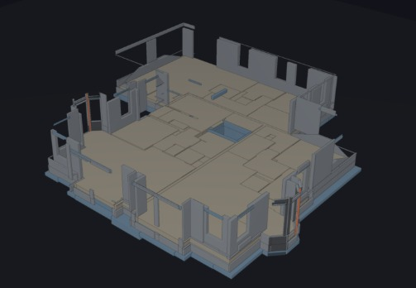
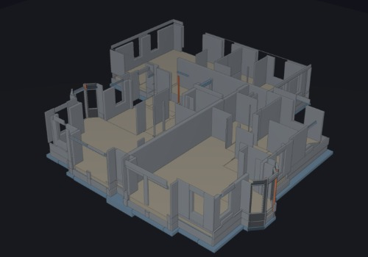
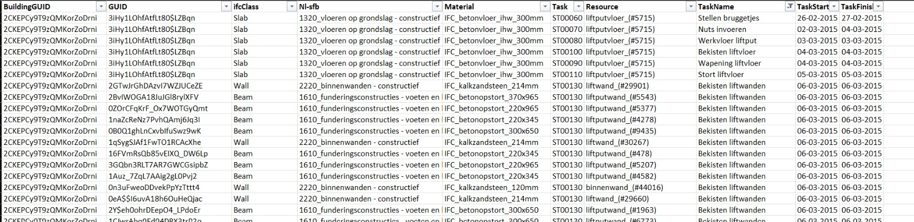
Simulated dataset
Partial Progress
Week 3
Week 4

Slide 5
Parsing the BIM into a canonical ground-truth table
Simulated
Drone Raycasting
Generate Point Clouds
Generate Realistic Construction Stages
Geometry Matching
Parse BIM
Calculate Progress
Projected Schedule

Slide 6
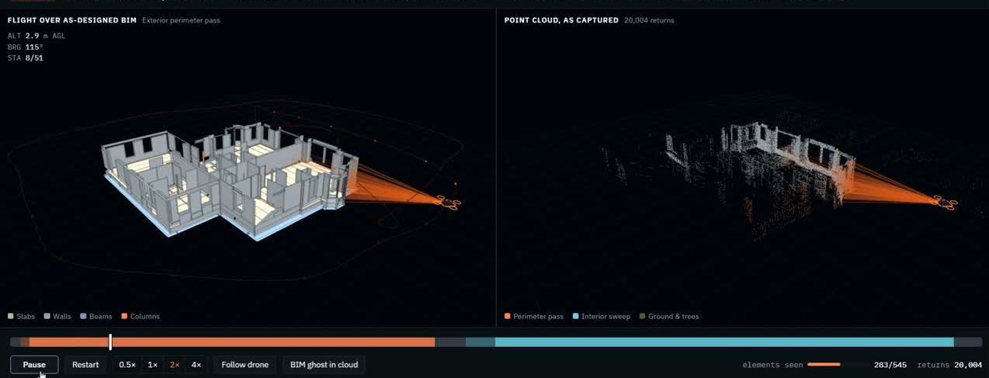
Point Cloud Generation
Drone Flight Path
RayCasting
Record 3D points
Add Noise

Slide 7
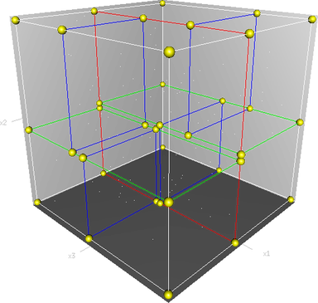
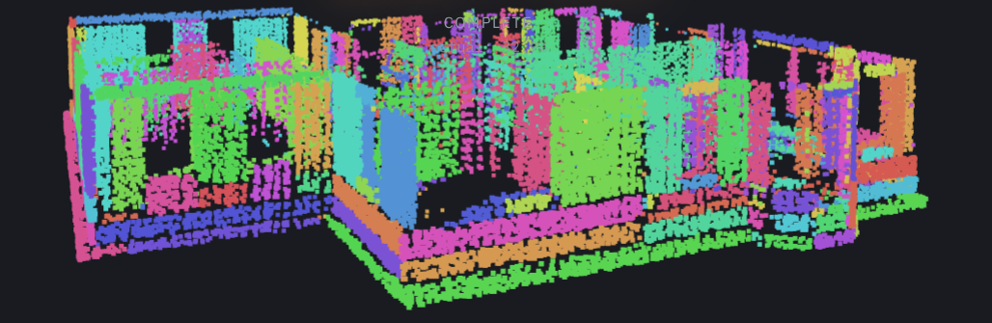
Matching Algorithm
The challenge is “which points belong to which known element”, not blind object discovery.
Build KD-Tree Reference
Assign Each Point to an Element
1. Sample complete BIM densely for each sample.
2. Tag each sample with its element's global_id
3. Build KD-tree index for fast lookup
1. Query KD-tree: find nearest BIM sample
2. Distance check:
- If distance < 8cm: assign to that element
- If distance ≥ 8cm: unassigned (noise/clutter)
3. Per element aggregation of point cloud
Register Stage Point Cloud
1. Coarse filter: keep only points within 0.5m of ANY BIM sample
(This rejects ground, trees, clutter with no BIM correspondence)
2. Run ICP (Iterative Closest Point) algorithm against BIM samples
ICP = iterative: guess alignment → refine → repeat → converge
3. Result: a rigid transformation (3D translation + rotation) that aligns the clouds
4. Apply transformation to all stage points

Slide 8
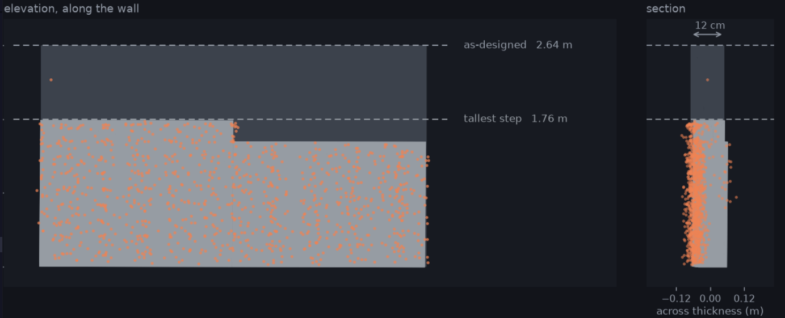
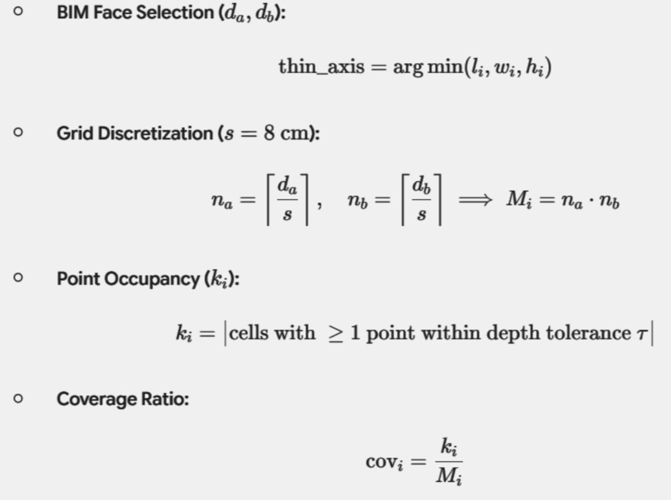

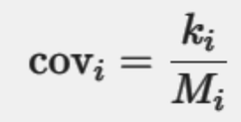
Stage-wise Progress Estimation

Slide 9
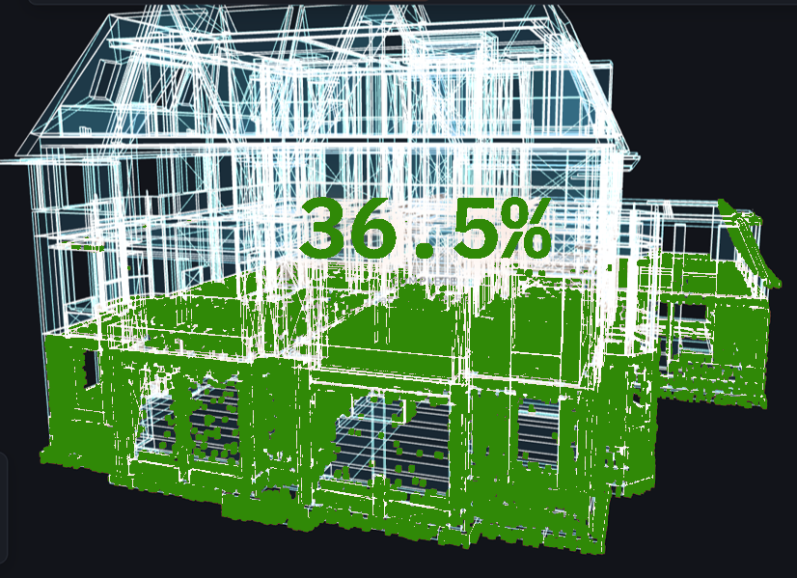
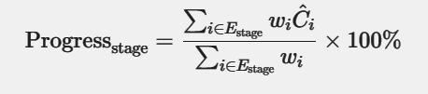
Stage-wise Progress Estimation

Slide 10
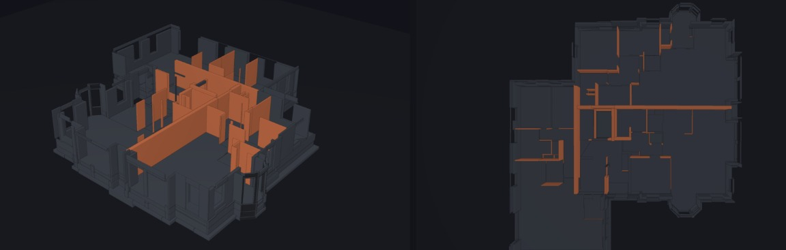
Progress Delta Calculation

Slide 11
Thank You

